Slide 1


Department of Computer Science and Engineering
Leveraging Deep Learning for Intelligent Driver Behaviour Analysis for Road Safety
MANOOJ KUMAR T A 211421104159
KISHAL T 211421104130
KRITHICK A 211421104324
PROJECT GUIDE:
SURESH S
ASSISTANT PROFESSOR
PROJECT COORDINATOR
Dr. JOSPHINE LEELA R
PROFESSOR

Slide 2
Abstract
Ensuring road safety is a critical concern globally, and understanding driver behavior plays a significant role in mitigating traffic accidents.
This paper presents a novel approach to intelligent driver behavior analysis by leveraging deep learning techniques, specifically Convolutional Neural Networks (CNN) and TensorFlow.
Our methodology focuses on analyzing vast amounts of driving data to identify patterns and anomalies that could indicate unsafe driving behaviors.
By training a CNN model on this data, we aim to achieve high accuracy in classifying and predicting various driver actions.
The proposed system is designed to process data, providing immediate feedback to drivers and potentially alerting them to hazardous behaviors before accidents occur.
The experimental results demonstrate that our model achieves superior performance compared to traditional methods, highlighting the efficacy of deep learning in enhancing road safety.

Slide 3
Introduction
Importance of Road Safety
Road accidents cause significant loss of life and property.
Human errors contribute to a majority of crashes.
Role of Driver Behavior in Accidents
Speeding, drowsiness, and distraction are major causes.
Need for real-time monitoring to prevent accidents.
Technology for Driver Safety
AI-powered driver assistance systems.
Sensors, cameras, and IoT for real-time analysis.
Deep Learning in Road Safety
Used for driver behavior analysis (e.g., detecting drowsiness).
Applications: object detection, facial recognition, predictive analytics.
Problem & Proposed Solution
Problem: Many accidents occur due to inattentive driving.
Solution: A deep learning-based system to monitor driver behavior and provide alerts.

Slide 4
Objective of the Project
Develop a deep learning-based system to analyze driver behavior by processing real-time data from cameras and sensors.
Identify and predict unsafe driving actions such as drowsiness, distraction, and reckless driving to enhance road safety.
Provide immediate feedback and alerts through visual, auditory, or haptic signals to help drivers correct their behavior.
Integrate AI-driven insights to assist in reducing accident risks by continuously monitoring and adapting to driving patterns.
Evaluate the system's performance using real-world datasets and compare its accuracy and efficiency with existing driver monitoring technologies.

Slide 5
Literature Survey
S.No | Title of Paper | Methodology | Advantage | Disadvantage
1: | Real-Time Driver Distraction Detection Using CNN | Used a Convolutional Neural Network (CNN) for image classification. | Achieved 92% accuracy; Efficient for real-time detection. | Requires high computational power for deep learning models.
2: | Automatic Detection of Driver Distraction Using ML | Used Random Forest classifier with hand and eye movement tracking. | Less computationally expensive than CNN models | Lower accuracy (85%) compared to deep learning methods.

Slide 6
Literature Survey
S.No | Title of Paper | Methodology | Advantage | Disadvantage
3: | Deep Learning Approach for Monitoring Driver Activities | Implemented a ResNet-based deep learning model. | Achieved 96% accuracy; Works well with large datasets. | Requires a large dataset for optimal performance.
4: | AI-Based System for Detecting Distracted Driving in Real-Time | Used YOLO (You Only Look Once) for fast object detection. | Real-time implementation possible; Faster than CNN models. | Lower accuracy (88%) in complex scenarios.

Slide 7
Literature Survey
S.No | Title of Paper | Methodology | Advantage | Disadvantage
5: | Impact of Mobile Phone Usage on Driving Performanc | Psychological study using reaction time measurements | Scientifically proved that texting increases accident risk by 23 times. | Not an AI-based solution; No automated detection.
6: | Driver Monitoring System Using Computer Vision | Used OpenCV and Haar Cascades for eye movement tracking. | Works in low-light conditions; Less computational power needed. | Accuracy is only 80%; Not robust in different lighting conditions.

Slide 8
Literature Survey
S.No | Title of Paper | Methodology | Advantage | Disadvantage
7: | A Comparative Study of ML Models for Driver Distraction Detection | Compared SVM, Decision Trees, Random Forest, and CNN. | Proved that CNN performs best for image-based tasks. | Traditional ML models had low accuracy (<80%).
8: | Improving Road Safety Through AI-Based Driver Monitoring | Integrated AI with sensor data (steering, acceleration, and images). | Real-world implementation; Combines multiple data sources. | Requires additional hardware (sensors & cameras) for implementation.

Slide 9
Problem Statement
Current methods for analyzing driver behavior are often insufficient.
Existing systems may not be accurate enough to reliably predict dangerous actions.
Lack of real-time feedback and intervention in current systems.
The need for a more robust and efficient solution to reduce accidents.
The limitations of the existing system (MFDS-STGCN) in terms of computational cost, lack of architectural comparison, and efficiency.

Slide 10
Proposed System
In the proposed system for leveraging deep learning for intelligent driver behavior analysis using CNN (Convolutional Neural Networks) and TensorFlow integrated with Django, the focus is on enhancing road safety through advanced data analytics.
This system aims to deploy a CNN model trained on extensive datasets to analyze driver behavior.
By processing this data with TensorFlow, the system can detect and predict behaviors such as drowsiness, distraction, aggressive driving, and adherence to traffic rules.
Django serves as the backend framework, facilitating seamless integration of machine learning models for predictive analysis.
The system not only identifies potentially risky behaviors but also provides timely alerts and feedback to drivers and fleet managers.
This proactive approach enables preemptive action to mitigate risks, thereby enhancing overall safety on the roads.

Slide 11
Software / Hardware used
Operating System: Windows
Tool: Anaconda with Jupyter Notebook & VS Code
Hardware Requirements:
Processor: Intel® Core™ i7 processor 14650HX (30M Cache, up to 5.20 GHz)
Hard disk: minimum 80 GB
RAM: minimum 4 GB

Slide 12
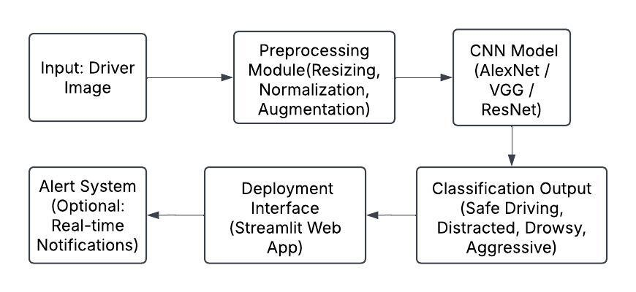
Architecture / Methodology used

Slide 13
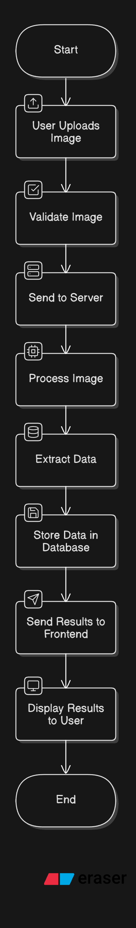
System Design - Flow Chart/DFD/ER

Slide 14
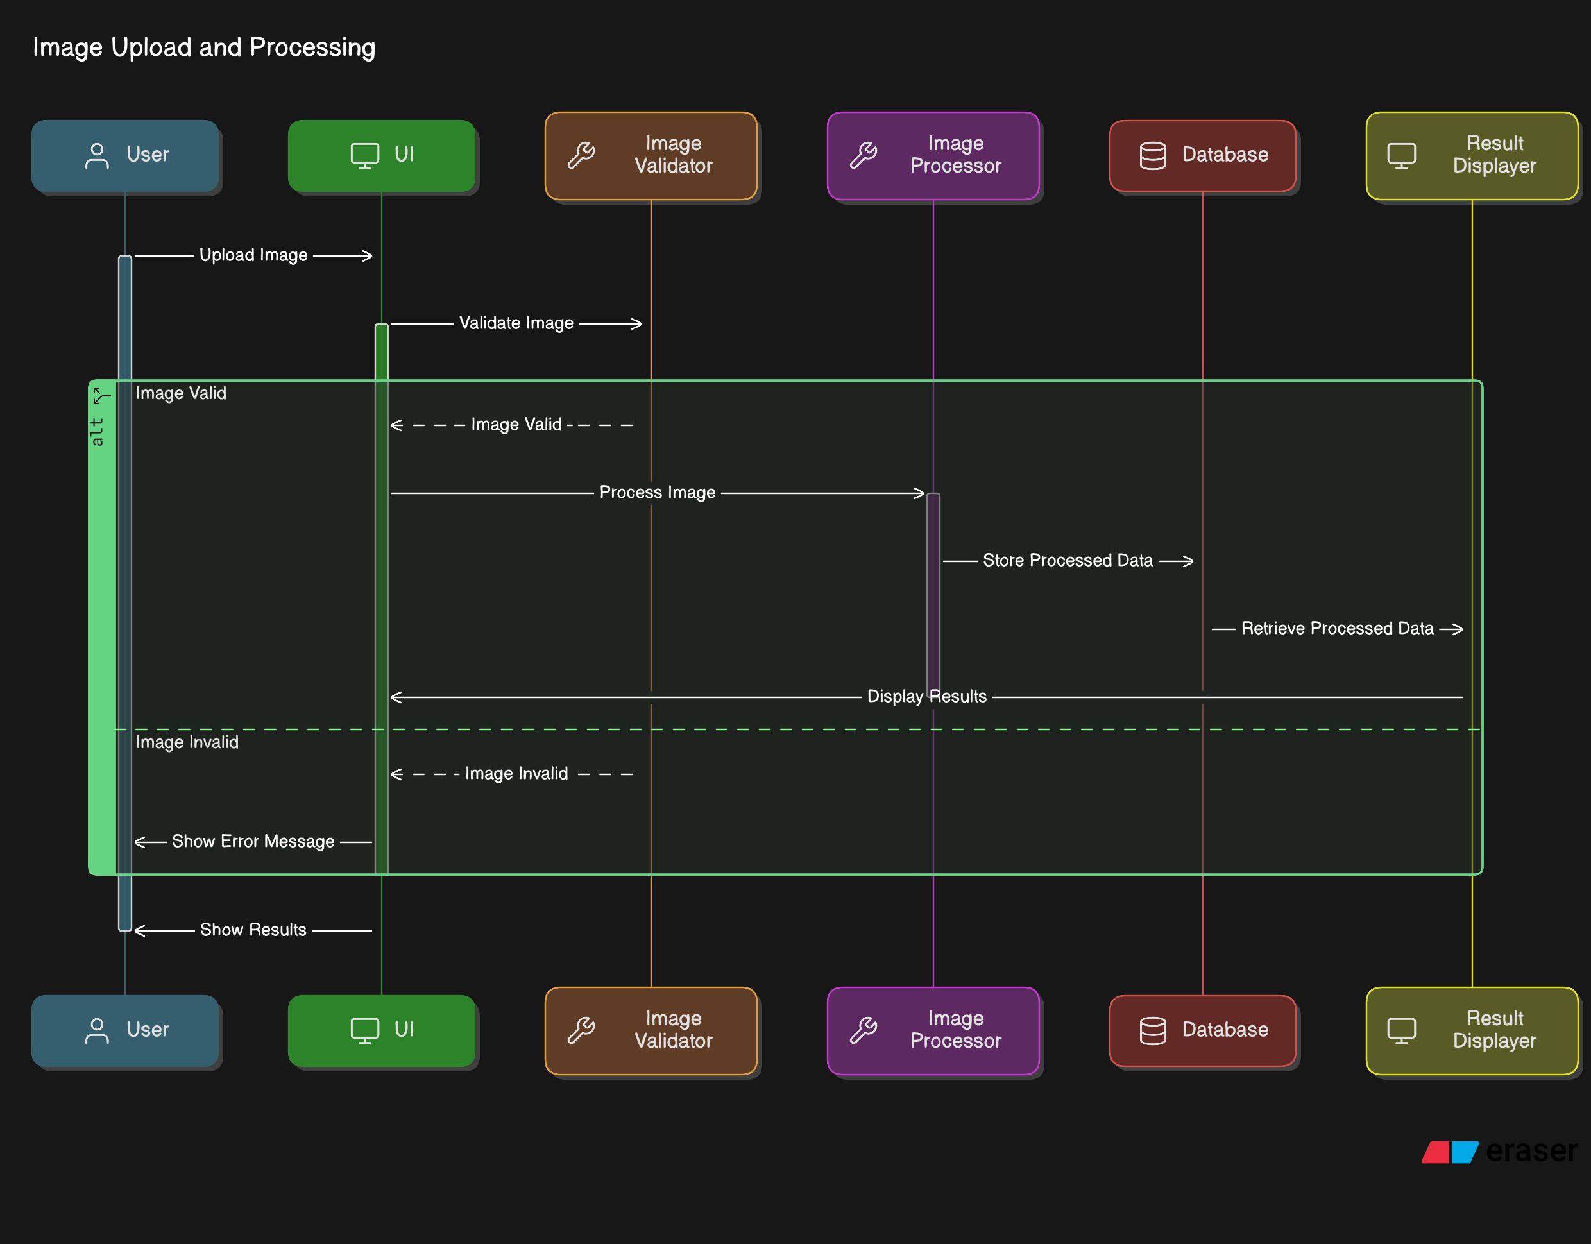
System Design - Flow Chart/DFD/ER

Slide 15
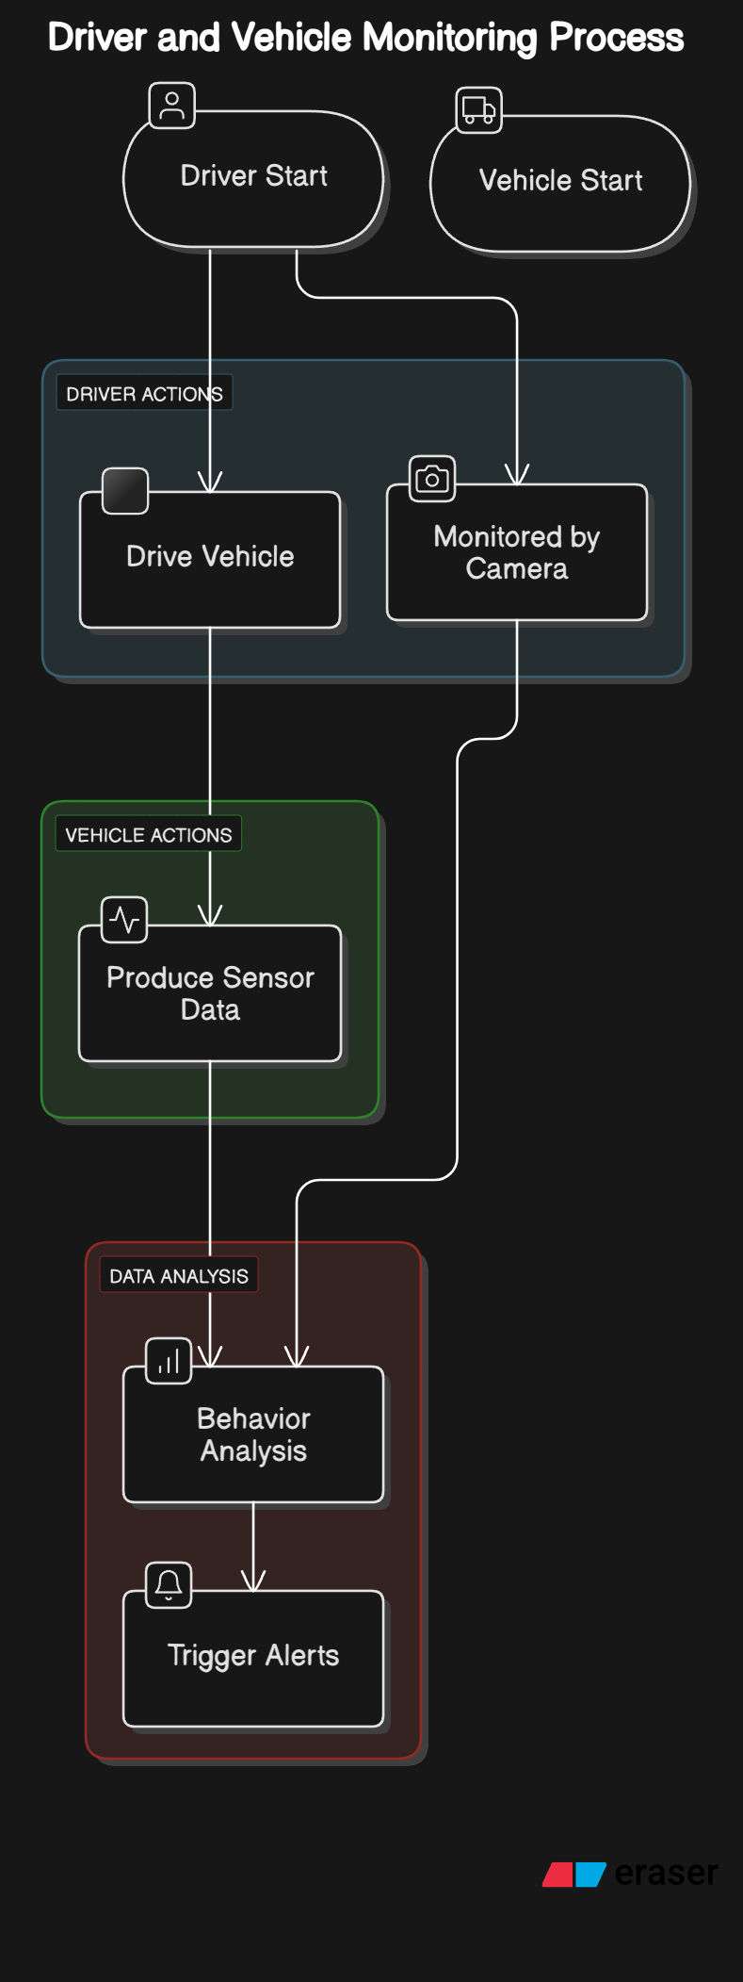
System Design - Flow Chart/DFD/ER

Slide 16
Module Description
1. Data Acquisition Module
📌 Purpose: Collects real-time data from various sensors and cameras.
🔹 Sub-Modules:
Sensor Data Collection: Captures speed, acceleration, braking, and steering angle.
Camera Data Capture: Uses a dashcam or webcam to record driver facial expressions, hand movements, and eye tracking.
External Factors: Weather conditions, road type (optional).

Slide 17
Module Description
Data Preprocessing Module
📌 Purpose: Cleans and prepares collected data for model training and inference.
🔹 Sub-Modules:
Image Preprocessing
Convert to grayscale
Resize to fixed dimensions (e.g., 224x224 for CNN models)
🔹 Technologies Used:
OpenCV for image manipulation
Scikit-learn & NumPy for sensor data normalization
🔹 Output:
Cleaned sensor & image data ready for ML models.

Slide 18
Module Description
Report Generation & Analytics Module
📌 Purpose: Stores behavior history & generates reports for driver analysis.
🔹 Sub-Modules:
Driver Performance Dashboard
Shows past incidents and risk analysis.
Admin Panel (for fleet monitoring)
Monitors driver behavior trends over time.
🔹 Technologies Used:
Flask/Django for web dashboard
Matplotlib/Seaborn for visualization
🔹 Output Example:
Weekly Report: "Driver had 3 distractions, 2 drowsiness events, and 1 aggressive turn."

Slide 19
Module Description
Alert System Module
📌 Purpose: Provides real-time alerts if unsafe behaviour is detected.
🔹 Sub-Modules:
Visual Alert (Dashboard display message)
Audio Alert (Buzzer or voice warning: "Wake up! You're drowsy.")
Haptic Alert (Vibration in the steering wheel)
🔹 Technologies Used:
Text-to-Speech (TTS) for voice warnings
IoT devices (buzzers, haptic feedback motors) for physical alerts
🔹 Output Example:
"ALERT! Keep your eyes on the road."
Final Outcome
✅ Detects unsafe driving behaviors (distracted, drowsy, aggressive driving). ✅ Provides real-time alerts to prevent accidents. ✅ Generates reports for driver performance tracking.

Slide 20
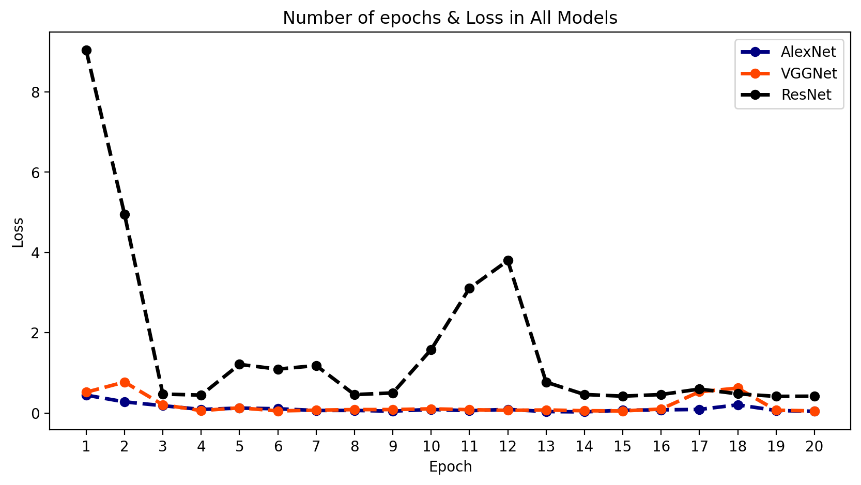
Testing /Performance Evaluation / Results

Slide 21
Testing /Performance Evaluation / Results

Slide 22
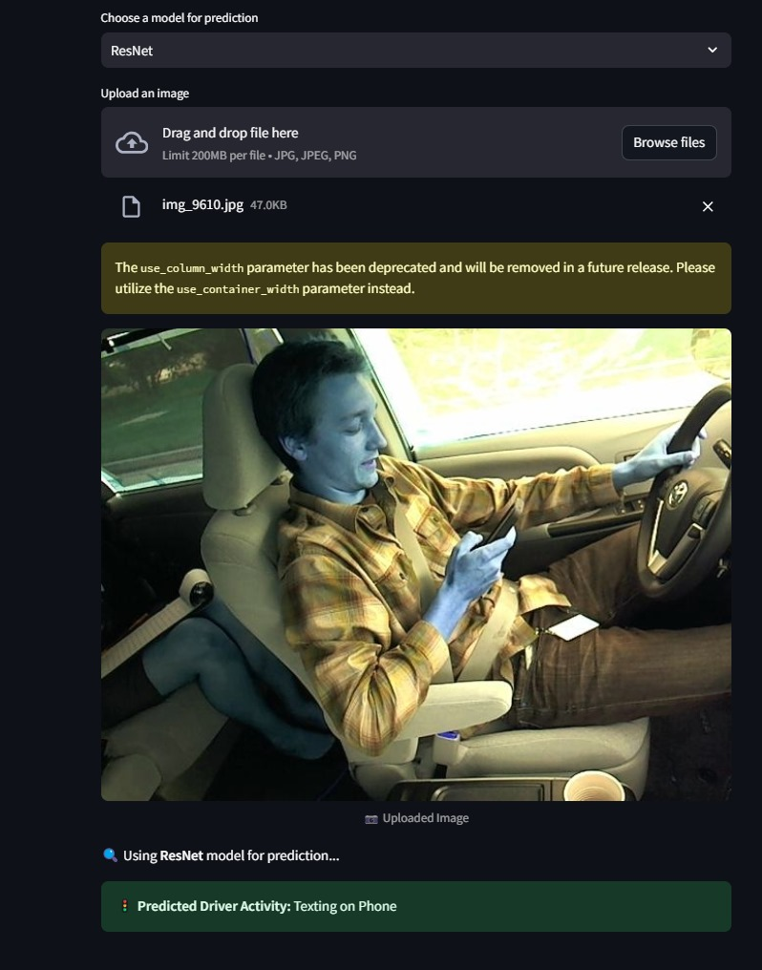
Screen Shots
➔Input
➔RESULT

Slide 23
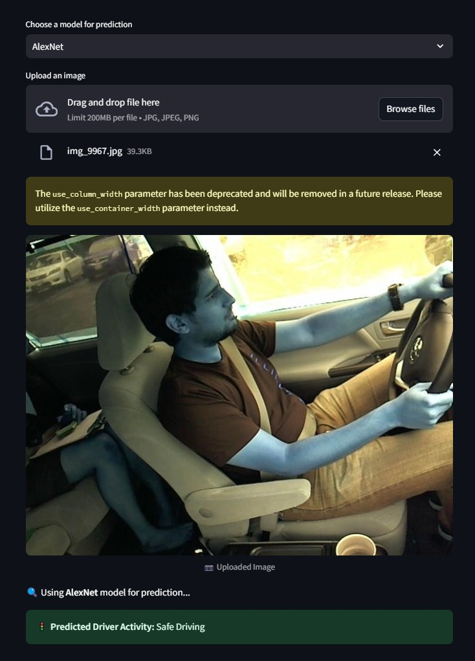
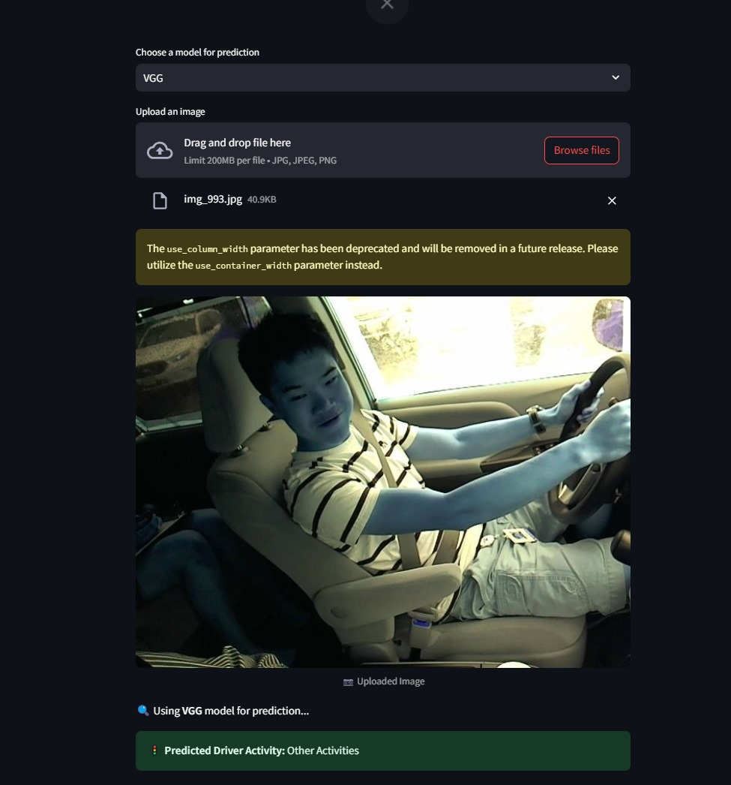
Screen Shots

Slide 24
Conclusion / Feature Enhancement
The Driver Behavior Detection System is a robust and efficient solution designed to classify and analyze driver behavior using image data. By leveraging advanced machine learning techniques, the system automates the process of detecting unsafe driving activities such as texting, talking on the phone, and other distractions. The system addresses critical challenges such as manual data processing, human errors, and the need for real-time monitoring. Through its intuitive interface, accurate classification, and interactive visualizations, the system empowers users to identify risky driving behaviors and take proactive measures to improve road safety.
Key Features and Benefits:
Automated Data Processing: The system automates the extraction, preprocessing, and classification of driver behavior data, reducing manual effort and minimizing errors.
Real-Time Monitoring: By integrating real-time image processing, the system can detect and alert users about unsafe driving behaviors as they occur.
Interactive Dashboards: The system provides interactive dashboards that visualize key metrics, such as the frequency of unsafe behaviors, enabling users to gain actionable insights.

Slide 25
Conclusion / Feature Enhancement
Customizable Alerts: Users can set up customizable alerts for specific behaviors, ensuring timely intervention and corrective actions.
Scalability: The system is designed to handle large datasets, making it suitable for fleet management, insurance companies, and individual drivers.
User-Friendly Interface: The intuitive interface ensures that users with minimal technical expertise can easily navigate and utilize the system.
The Driver Behavior Detection System is a cutting-edge solution that addresses the growing need for safer driving practices. By automating the detection of unsafe behaviors and providing actionable insights, the system empowers users to reduce risks, improve compliance, and enhance overall road safety. With the proposed feature enhancements, the system can further evolve into a comprehensive tool for real-time monitoring, behavioral analytics, and decision support, making it an indispensable asset for individuals, businesses, and organizations focused on driver safety

Slide 26
Reference Paper/ URL
Qu, Y., Liu, Y., Zhou, D., & Azadani, M.N. (2023). Driver State Monitoring Technology for Conditionally Automated Vehicles: Review and Future Prospects. IEEE Transactions on Instrumentation and Measurement.
Liu, Y.Q., & Wang, X.Y. (2020). The Analysis of Driver's Behavioral Tendency Under Different Emotional States Based on a Bayesian Network. IEEE Transactions on Affective Computing.
Zhou, D., Lu, C., & Wang, Z. (2021). Driving Behavior Prediction Considering Cognitive Prior and Driving Context. IEEE Transactions on Intelligent Transportation Systems.
Azadani, M.N., & Boukerche, A. (2022). Driving Behavior Analysis Guidelines for Intelligent Transportation Systems. IEEE Transactions on Intelligent Transportation Systems.
Wang, Z., Luo, Y., & Kashevnik, A. (2022). A Survey on Driver Behavior Analysis From In-Vehicle Cameras. IEEE Transactions on Intelligent Vehicles.

Slide 27
Reference Paper/ URL
6.Luo, Y., Chai, W., & Rahim, M.A. (2022). Detecting Driver Cognition Alertness State From Visual Activities in Normal and Emergency Scenarios. IEEE Transactions on Intelligent Transportation Systems
7.Kashevnik, A., Rahim, M.A., & Chai, W. (2020). Methodology and Mobile Application for Driver Behavior Analysis and Accident Prevention. IEEE Transactions on Intelligent Transportation Systems.
8.Chai, W., Lu, C., & Azadani, M.N. (2024). Rethinking the Evaluation of Driver Behavior Analysis Approaches. IEEE Transactions on Intelligent Transportation Systems.
9.Lu, C., Wang, Z., & Zhou, D. (2020). Transfer Learning for Driver Model Adaptation in Lane-Changing Scenarios Using Manifold Alignment. IEEE Transactions on Intelligent Transportation Systems.
10.Rahim, M.A., Azadani, M.N., & Boukerche, A. (2020). Zero-to-Stable Driver Identification: A Non-Intrusive and Scalable Driver Identification Scheme. IEEE Transactions on Vehicular Technology.

Slide 28

Conference / Publication / Patent Certificate/ Project Contest Winner Certificates

Slide 29

Conference / Publication / Patent Certificate/ Project Contest Winner Certificates

